Slide 1
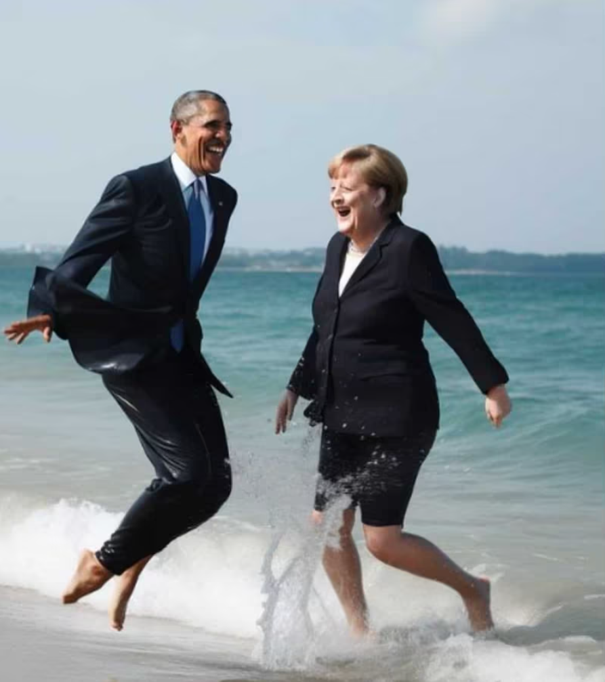
Artificial Facial Detection: Separating Real Faces from the Artificially Generated
Egor Zakharov Skolkovo Institute of Science
Udhbhav Gupta & Ante Tonkovic-Capin
@julian_ai_art/Instagram

Slide 2
Introduction - AI Fueled Arms Race
Technology for creating artificially generated images has become increasingly sophisticated.
Breakthroughs in artificial generation lead to new efforts to identify and detect forgeries, leading to an arms race in the field between generation and detection techniques
The potential for malicious use and spreading misinformation is immense
Our project aims to explore the potential of implementing an AI-generated detection system for facial images using a two-phase pipeline

Slide 3
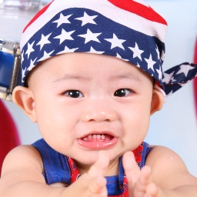
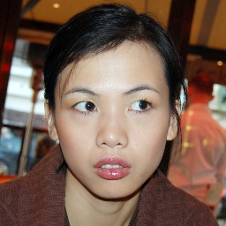

Real or Fake?

Slide 4

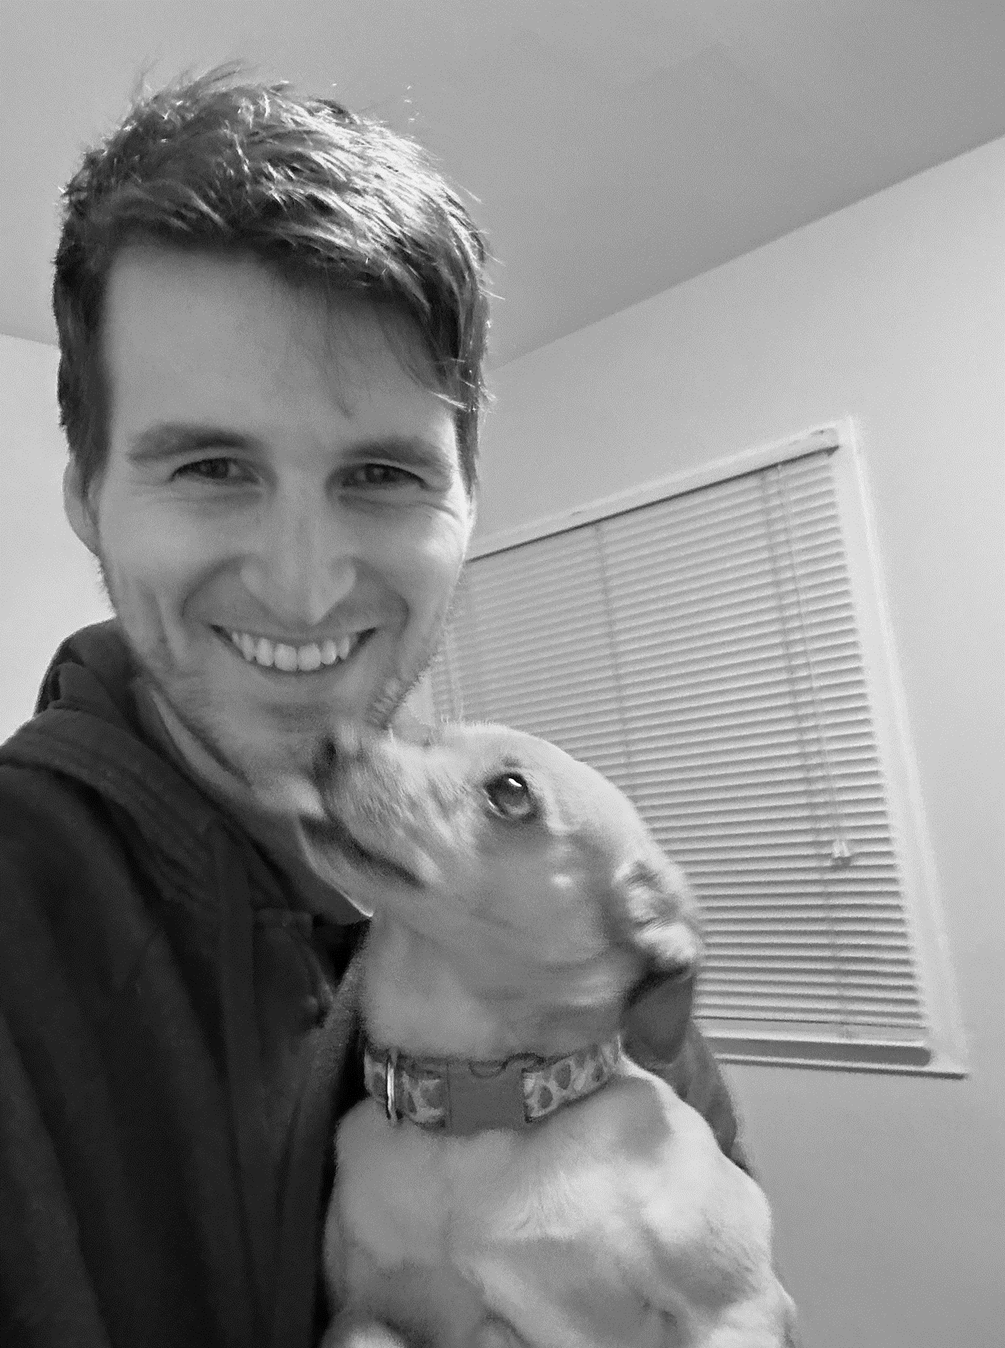


Defining Classification: What does it mean to be a “Real Face”
The face, as digitally represented, is considered real if it existed physically as a biological human at a moment in time and faithfully depicts the countenance, demeanor and position originally expressed by the digital representation such that the average observer’s prima facie impression closely reflects the reality of the moment captured digitally.
Right image generated using Stable Diffusion model at https://www.artguru.ai/ai-text-to-image-generator using left-most image as input

Slide 5
Related Work
Image Artifact Based Approaches
watermarks, sensor noise patterns, file format compression signals, lens aberrations etc.
Deep CNN models
Color statistics feature set
DeepFD: Joint discriminative feature learning with contrastive loss
Notes:
There has been research done on detection models based on image artifacts like but such approaches have been shown to work well on traditional methods of image forgery like photoshop but not so much on AI generated images
These work well on the dataset that they are trained on. End up replicating the Discriminator part of the specific GAN, don’t generalize well to detecting images from other GANs
Taking the notion of generalization one step further to all kinds of generated images not specifically faces, a research team developed a feature set from image color statistics. Detection models based on this feature set have generalized well
Lastly a joint feature learning and classification model has been proposed by another research team which uses contrastive loss to try and model common underlying features of fake images that differ from real images

Slide 6
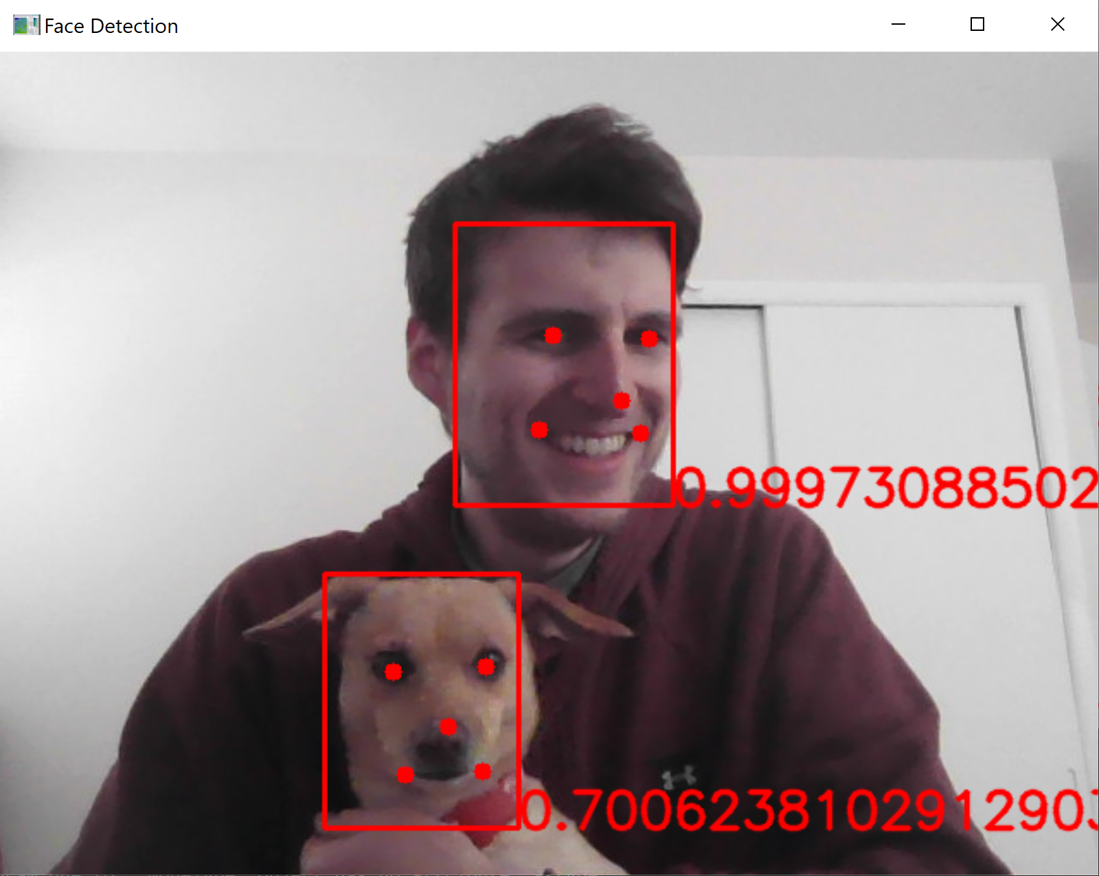
Facial Detection using MTCNN
Facial detection using Multitask Cascaded Convolutional Networks (MTCNN)
Extract using resultant bounding box and center on features
Resize and normalize as new image for input to CNN
Multitask comes from the cascading architecture with three tasks: Propose, Refine and Output
Zhang, K., Zhang, Z., Li, Z., and Qiao, Y. (2016). Joint face detection and alignment using multitask cascaded convolutional networks. IEEE Signal Processing Letters, 23(10):1499–1503.

Slide 7


Facial Detection and Extraction Example
Highest probability beyond specified threshold chosen as facial feature, extracted, resized, post-processed and normalized prior to input to CNN

Slide 8
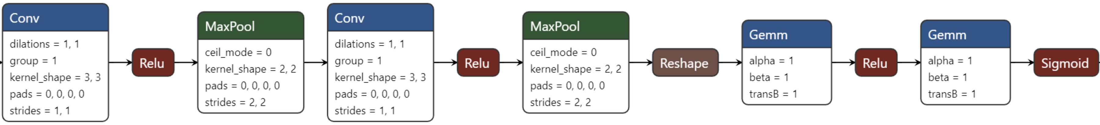
CNN Binary Classifier
Used dataset comprising 70,000 real faces from Flickr and 70,000 fake faces generated from the StyleGAN model, originally collected and provided by Nvidia
Facial image extracted from phase 1 passed through CNN comprised of two convolutional layers and two fully connected ones yielding output for binary classification
https://www.kaggle.com/datasets/xhlulu/140k-real-and-fake-faces

Slide 9
Best Results & Model Pipeline to Date:
Image
┌───────────┬─────────────────────┐
│ P1 Model │ MTCNN (0.5M params) │
│ P2 Model │ CNN (11.9M params) │
│ Results │ 8852 of 9998 │
│ Accuracy │ 88.54% │
│ Loss │ 0.4020 │
│ TP │ 4604 │
│ FP │ 751 │
│ FN │ 395 │
│ TN │ 4248 │
│ Precision │ 0.86 │
│ Recall │ 0.92 │
│ F1-Score │ 0.89 │
└───────────┴─────────────────────┘
MTCNN for face detection, bounding box regression and facial landmark localization tasks
Proposal-Net
Refine-Net
Output-Net
CNN for facial binary classification
Real or Fake
79x79x48
Conv: 3x3
MaxP: 2x2
38x38x128
Conv: 3x3
MaxP: 2x2
64x184832
64x1
σ(x)
FC1
FC2
MTCNN Paper: Long-Hua Ma, Hang-Yu Fan, Zhe-Ming Lu, Dong Tian (2020), Acceleration of multi-task cascaded convolutional networks. IET Image Process., 14: 2435-2441. https://doi.org/10.1049/iet-ipr.2019.0141
Notes:
Series of 3 small CNNs
P-Net: generates candidate bounding boxes
R-Net: refines and eliminates false positive bounding boxes, predicts facial landmarks like eyes, nose, mouth
O-Net: final calibration on bounding boxes, refines landmark predictions
Followed by the classification CNN
2 convolutional layers and a feed forward network with 2 hidden layers
Outputs a probability of an image being real

Slide 10
Exploratory Results & Various Approaches
Initially explored a couple different datasets and models, including pretrained CNNs for classification
┌────────────┬────────────┬────────┬────────────┬───────────┬──────────┐
│ Model │ Parameters │ Epochs │ Learn Rate │ Dataset │ Accuracy │
├────────────┼────────────┼────────┼────────────┼───────────┼──────────┤
│ vit-l-32 │ 306.5M │ 20 │ 5e-3 │ StyleGAN │ 50.18% │
│ vit-b-16 │ 86.6M │ 20 │ 1e-2 │ Photoshop │ 52.58% │
│ ffd-1k │ 1.6M │ 20 │ 3e-4 │ Photoshop │ 54.23% │
│ ffd-5k │ 1.6M │ 20 │ 3e-4 │ StyleGAN │ 77.90% │
│ ffd-5k │ 1.6M │ 80 │ 1e-4 │ StyleGAN │ 78.70% │
│ ffd-5k │ 1.6M │ 80 │ 2e-4 │ StyleGAN │ 79.30% │
│ ffd-5k │ 1.6M │ 50 │ 3e-4 │ StyleGAN │ 80.20% │
│ ffd-10k │ 11.8M │ 50 │ 2e-4 │ StyleGAN │ 83.30% │
│ ffd-50k │ 11.8M │ 10 │ 1e-4 │ StyleGAN │ 92.14% │
│ ffd+fe-10k │ 11.8M │ 50 │ 2e-4 │ StyleGAN │ 78.16% │
│ ffd+fe-50k │ 11.8M │ 10 │ 1e-4 │ StyleGAN │ 88.50% │
└────────────┴────────────┴────────┴────────────┴───────────┴──────────┘
Photoshop Dataset: https://www.kaggle.com/datasets/ciplab/real-and-fake-face-detection Computational Intelligence and Photography Lab, Yonsei University
Notes:
Initially started our project by analyzing which model type would work best for fake image classification. Candidates: Vision Transformer, CNN
Vision Transformer is a relatively new architecture that divides images into patches, converts patches into vector embeddings, and then uses a transformer encoder to learn dependencies and relationships between different parts of the image
Generally have been shown to do well on image classification but didn’t work well for us in detecting fake images. Likely due to less emphasis on local features than global relationships, and perhaps needs larger dataset
Other model was CNN as discussed earlier
We trained both model types with different configurations and hyperparameters and on different datasets
Eventually ended up with this configuration for the cnn

Slide 11

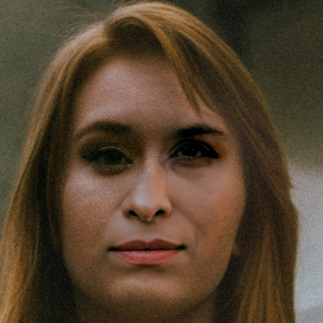
Facial Extraction (FE) Impact
Dataset | Test Accuracy (%)
 | Without FE | With FE
StyleGAN + Real | 92.14 | 88.50
StarGAN + Real | 44.77 | 50.11
Photoshop + Real | 81.07 | 90.68
StyleGAN Generated Face
Without FE: Real (0.9997)
With FE: Fake (0.2559)
Photoshop Manipulated Face
Without FE: Real (0.9846)
With FE: Fake (0.0265)
Notes:
Goal of our project is to show that fake facial image detection works better with facial extraction
However you’ll notice that the Test accuracy is higher without FE on stylegan. We believe this is because
Without FE the model obviously has more background pixels to learn from (256x256 vs approx. 160x160 of the bounding box), so it captures information about synthetically created general pixels better but those background pixels don’t provide any info about synthetically generated facial features which we ideally want our model to capture
And one reason why we do believe FE works better is because by reducing the image to just the face, we force the model to capture information about different facial orientations better (talk about image)
After training both models only on the StyleGAN dataset, we also wanted to test how they generalize to datasets of other fake images
Unsurprisingly test accuracy was low on StarGAN. And as discussed earlier this observation is in line with the fact that regular CNNs only tend to work well for the GAN whose images they are trained on and don’t generalize well to other GANs
However the model did surprisingly well for photoshopped faces dataset that we didn’t necessarily expect
the most important observation we made was that the CNN model with FE, despite being trained only on StyleGAN images, had much better accuracy on unknown datasets than the model without FE

Slide 12
Conclusion
MTCNN is one of the most accurate facial detection models. For inference tasks, it is fast, accurate and also identifies facial landmarks
Pre-processing image data with MTCNN for facial extraction provides more reliable results from the CNN classifier and tends to generalizes better
Classifying images as real or AI generated remains a challenge and active area of research, particularly from a generalization perspective
Next Steps
Model parameter tuning
Model training and performance analysis on heterogenous dataset
Notes:
To summarize

Slide 13
Q/A

